Slide 1
Embedded System
Introduction to Embedded System
Let’s first know the two basic things i.e. embedded and system, and what actually do they mean. System is a set of interrelated parts/components which are designed/developed to perform common tasks or to do some specific work for which it has been created.
Embedded means including something with anything for a reason. Or simply we can say something which is integrated or attached to another thing.

Slide 2
Now after getting what actually systems and embedded mean we can easily understand what Embedded System is.
Embedded System is an integrated system that is formed as a combination of computer hardware and software for a specific function. It can be said as a dedicated computer system has been developed for some particular reason. But it is not our traditional computer system or general-purpose computers, these are the Embedded systems that may work independently or attached to a larger system to work on a few specific functions. These embedded systems can work without human intervention or with little human intervention.

Slide 3
Components of Embedded Systems
Three main components of Embedded systems are:
Hardware
Software
1. Hardware: The hardware components of embedded systems encompass various physical elements that comprise the system infrastructure. These include power supply, microcontrollers and microprocessors, memory, timers and counters, communication interfaces, input/output, and electrical circuits, all of which work together to enable the desired functionality of the embedded system.
2. Software: Unlike computer software, which can be installed on different devices to achieve the same goal, embedded system software is specifically written for a particular type of device, and its goals are much narrower in scope.

Slide 4
The hardware components of embedded systems are:
Power supply
The power supply component is an electrical unit responsible for powering up the electrical load of the embedded system. While a 5V power supply is generally required, the range can go from 1.8V to 3.3V, depending on the application.
To ensure seamless system operations, a smooth and efficient power supply is a must. The power supply unit can either be live (such as from a wall adapter) or battery-powered. Some embedded systems use an independent power supply, while others leverage the same source as the larger technology being powered.
Microcontroller and microprocessor
Embedded systems come in two key variants: microcontroller-powered and microprocessor-
powered. A form of integrated circuits, these components give the system its computing power. In simple terms, the microcontroller or microprocessor serves as the brain of the embedded system and drives its performance.

Slide 5
Processors range from 8-bit to 16-bit to 32-bit, with the main difference in processing speed and throughput. For instance, a 32-bit processor has a higher processing speed since it can manipulate 32 bits at once, while a 16-bit processor has a comparatively lower processing speed as it manipulates only 16 bits at a time. So why don’t all embedded systems come fitted with 32- bit processors? It’s simple. Not all applications require high processing speed and associated higher costs!
Memory
The memory component is essential for storing critical data in embedded systems. This component is generally integrated into the microprocessor or microcontroller. The two types of memory are RAM (random access memory) and ROM (read-only memory).
RAM is also known as the ‘data memory’ and is volatile, which means that it stores information only temporarily and is wiped clean when the power supply is turned off. On the other hand, ROM is also known as the ‘code memory’ and is responsible for storing the program code. It is non-volatile, storing system information even when the power supply is turned off.

Slide 6
Timer and counter
Timers are used in applications requiring the creation of a delay before the execution of a specific function by the embedded system. On the other hand, counters are used in applications where the number of times a specific event takes place needs to be tracked. Up counters count upward from the starting value to 0xFF, while down counters count downward to 0x00. Counters are integrated into the system using register-type circuits.
Input/output
Input components allow other components within the larger interconnected infrastructure to
interact with the embedded system. For instance, a sensor helps provide inputs for the system to process. Once processing is complete (for instance, counting), the results are communicated to the required destination via the output component.

Slide 7
Communication interface
Communication interfaces enable embedded systems to establish communications with each other and other components within the larger system. Different interfaces include USB, I2C, UART, RS-485, and SPI. For simple applications, communication ports within the microcontroller are utilized, and ports can be externally installed in case of advanced applications.

Slide 8
The software components of embedded systems are:
Compiler
This component’s core function is the development of an executable program. Once the code is prepared in the text editor, the machine must understand it. This is achieved with the compiler’s help, translating the written code into low-level machine language. Examples of low-level languages include machine code, assembly language, and object code.
Assembler
The assembler is for instances where assembly language is the programming language used to build the application. The assembly language program is translated into HEX code for further processing. Once the code is written, the programmer is used to write the program on the chip.
This is slightly different than the process followed in a compiler. In the compiler, written code is directly converted into machine language. On the other hand, the assembler first converts source code to object code, after which the object code is converted into machine language.

Slide 9
Text editor
A text editor is the first software component needed for building an embedded system. This editor is used to write source code in C and C++ programming languages and save it as a text file.
Emulator
This component makes the embedded system behave like a real, live system while operating in a simulation environment. Simply put, it simulates software performance and helps ensure that
the performance of the written code is ideal. The emulator is used to gain an idea of the way the code will operate in real time.
Link editor
Software code is generally written in small-sized pieces and modules. The link editor, also
known as a ‘linker,’ is the component used to take one or more object files and integrate them to develop a single executable code.
Debugger
Finally, the debugger is a software component used for debugging and testing. It is responsible for scanning the code, removing bugs and other errors, and highlighting the specific instances
where they occurred. The debugger helps programmers address errors swiftly.

Slide 10
Types of Embedded Systems
When considering performance and functional requirements, embedded systems are categorized into real-time embedded systems, standalone embedded systems, networked embedded systems, and mobile embedded systems.
Real-time embedded systems prioritize prompt output generation and can be classified as soft real-time (lenient deadlines) or hard real-time (strict deadlines).
Standalone embedded systems can function independently without a host computer.
Networked embedded systems rely on network connections and communication for output generation.
Mobile embedded systems refer to small, portable devices such as smartphones and laptops.
Finally, when classified based on microcontroller performance, embedded systems are divided into small-scale, medium-scale, and sophisticated categories, depending on the bit size of the microcontroller.

Slide 11
Examples of embedded systems
Digital watches
Washing Machine
Toys
Televisions
Digital phones
Laser Printer
Cameras
Industrial machines
Electronic Calculators
Automobiles
Medical Equipment

Slide 12
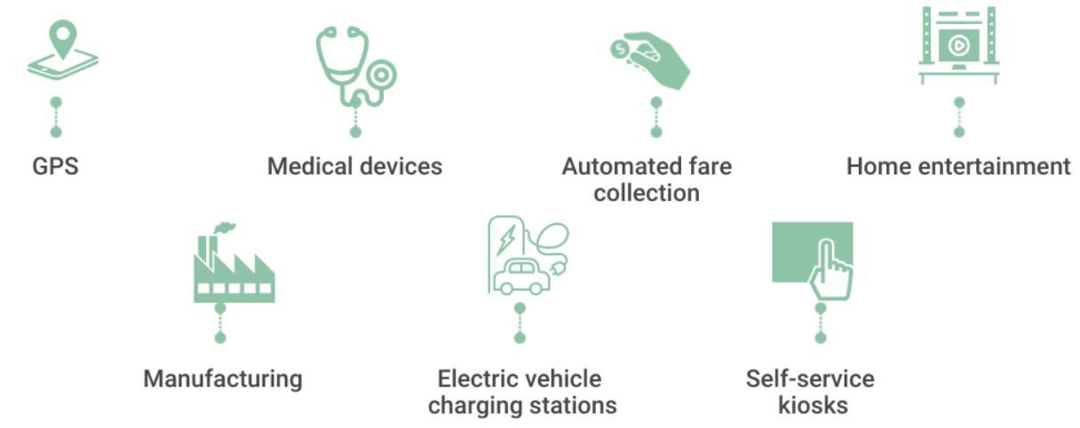
Application areas of Embedded System:
Mostly Embedded systems are present everywhere. We use it in our everyday life unknowingly as in most cases it is integrated into the larger systems. So, here are some of the application areas of Embedded systems:

Slide 13
GPS
The global positioning system (GPS) uses satellites and receivers to synchronize location, velocity, and time data to provide a navigation system the world can use. GPS systems are commonly used in vehicles and mobile devices. All ‘receivers’ (devices that receive GPS data) are integrated with embedded systems to enable the use of the global positioning system.
Medical devices
Cutting-edge medical devices with embedded systems are used for patients requiring constant monitoring. For instance, embedded sensors gather health data such as readings from implants, pulse rate, and heart rate. This data is then transmitted to a private cloud, where it can be reviewed automatically by an alert system or manually by a medical professional.

Slide 14
Automotive
Embedded systems in automotive applications enhance overall safety and user experience. Key examples of embedded systems in action are adaptive speed control, pedestrian recognition, car breakdown warning, merging assistance, airbag deployment, anti-lock braking system, and in- vehicle entertainment equipment.
Automated fare collection
Automated fare collection solutions enable public transportation passengers to pay their fares through automated machines or even online without interacting with another human being. The automatic transit fare collection ecosystem consists of ticketing machines, magnetic stripe cards and smart cards for regular travelers, ticket and card checking machines, and automatic gate machines. All these components include embedded systems to enable them to communicate with each other and thus keep the mechanism operational.

Slide 15
Fitness trackers
Fitness trackers have become increasingly popular wearable devices that monitor health metrics and track activities such as running, walking, and sleeping. These devices leverage embedded systems for data collection such as heart rate, body temperature, and steps walked. This data is transmitted to servers via a wide area network (WAN) such as LTE or GPRS.
Home entertainment
Entertainment systems such as televisions are a mainstay in homes worldwide. Embedded systems are key in reading inputs from connectors, such as the antenna, DisplayPort, HDMI, and Ethernet. Besides this, remote controls transmit infrared signals for reading by televisions. Smart televisions even include an operating system that supports internet and streaming applications. Embedded systems play an important role in these functions and are gaining more ground as new ways to make home entertainment even smarter are discovered.

Slide 16
Automated teller machines
Automated teller machines (ATMs) are large computerized electronic devices used globally in the banking sector. During a transaction, an ATM communicates with its host bank computer over a network connection. The bank computer verifies the data entered during the transaction and stores processed information. At the same time, the ATM uses embedded systems to process user inputs from the field and display the transaction data from the bank computer.
Manufacturing
Factories today use robots in several processes that require high-precision tasks, operating in dangerous work conditions, or both. Typical automated jobs require robots to be fitted with sensors, actuators, and software that allow them to ‘perceive’ the environment and derive the required output efficiently and safely. Robots are equipped with embedded systems that link them to various subsystems to achieve this goal.

Slide 17
Electric vehicle charging stations
Electric vehicle charging stations supply electric power to recharge the batteries of connected electric vehicles. Embedded systems are used in charging stations to provide computing power for graphics displays, automatically highlight technical issues, and alert technicians about upcoming maintenance requirements, among other functions.
Self-service kiosks
Finally, we have interactive self-service kiosks that offer users information and services in environments where a human employee’s presence is unfeasible. Think of a ticketing kiosk catering to moviegoers for a 2 a.m. screening at a mostly empty theater. Self-service kiosks come in various forms, from snack vending machines to refueling stations with self-checkout equipment. These kiosks can be found at airports, retail stores, hospitals, government buildings, and many other locations. Embedded systems provide the computing power required for these kiosks to offer customers an interactive experience.

